Slide 1
Group Policy
Preferences to Software and Everything in Between

Slide 2
Welcome!
Who am I? Joseph Moody
My goal: teach you Group Policy from a practical level
What I am not: an expert at Group Policy.
Who are you?
Your goals?
Notes
  There will be boring parts – just learn them and stick with me.
  Details/Examples are for Windows Vista+. XP and below can be different

Slide 3
Lab Notes
Physical Machine Logon:
  Localadmin (or administrator)
  P@sswOrd <that is a zero or asdfasdf
Default User: Administrator
Default Password: P@sswOrd <that is a zero
Domain Name: Test.local
.\ lets you login locally on clients
Group Policy Event Log is found under Applications and Services\Microsoft\Windows\Group Policy
Until we cover processing, keep things simple.

Slide 4
Lab
Launch Hyper-V Manager
Create a new virtual switch – the switch type is internal. Verify it is an internal switch
Have someone else verify…
Create two virtual machines named: DC-01 and Client-01
Assign them 1024 MB of memory with Dynamic
Connect them to your new virtual switch
Select Use an Existing virtual hard disk. Browse to C:\Users\Public\Hyper-V\
Start DC-01 and log in as the domain administrator. Change your IP to 192.168.0.1 with a subnet mask of 255.255.255.0. Press Yes to any warnings.
Start Client-01
Start DC-01 first. Log in as domain administrator.

Slide 5
Group Policy?
What is Group Policy?
  A centralized management and configuration tool for computers and users. No extra client or servers beyond a DC is required.
What can it do?
  Pretty much everything: 1,000s of On/Off Settings, dozens of configuration tools, and the ability to deploy batch, VB, or PowerShell scripts
What is it comprised of?
  A service (GPClient) on every machine, Active Directory/Sysvol for Group Policy Objects (GPOs), a Group Policy Management Console (GPMC)

Slide 6
Boring Definitions
Group Policy: the overall technology. Named because you are grouping policies and settings together.
Group Policy Object (GPO): an individual object that contains your settings
Policy (setting): also known as a registry setting or administrative setting. These are the individual Enable/Disable settings you can configure in a GPO
policy: a specific type of setting that users cannot change
Group Policy Preferences (GPP): an add-on for Group Policy that is built into Windows 7. An example would be Group Policy Preferences (GPP): Printers
Preference (setting): an individual item within a specific GPP (like Printers)
preference: a specific type of setting that users can change

Slide 7
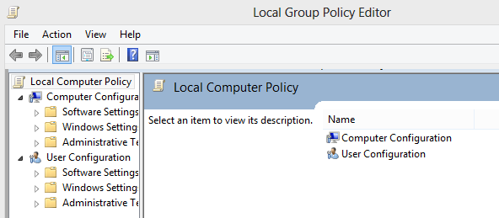
Local Group Policy Objects (LGPOs)
Business Editions of Windows include at least 1 local Group Policy Object
Applies to all users logging into a machine
Accessed by Launching GPEDIT.MSC
Stored at: C:\windows\system32\grouppolicy

Slide 8
LGPOs VS Active Directory GPOs
LGPOs
  Work in off domain environments
  Extremely fast to process
  Have to be set on a machine by machine basis
  Not all features available such as Software Installation
AD GPOs
  For domains only
  Slightly slower to process
  Able to massively set changes
  Tons of features and extensions

Slide 9
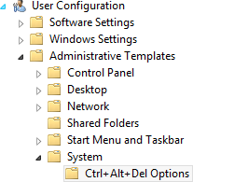
Reading the Map
GPOs are divided up into two sections: Computer and User. These are collectively called nodes.
So if I said, find User Configuration/Administrative Templates/System – here is where you would look:

Slide 10
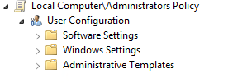
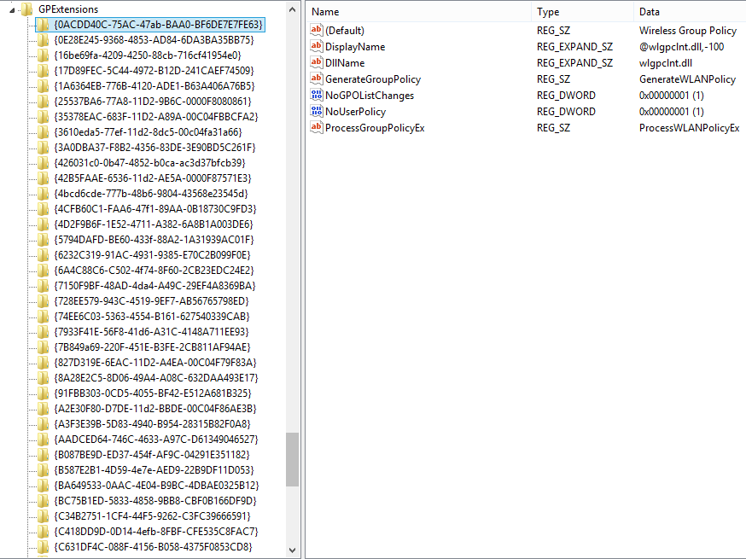
Pieces of a Policy
A single GPO lets you configure options that are processed by many Client Side Extensions (CSEs)
CSEs add functionality to GP
  Software Installation
  Security
  Registry
  Each Preference: Printers, Files
Full list: HKLM\SOFTWARE\Microsoft\Windows NT\CurrentVersion\Winlogon\GPExtensions

Slide 11
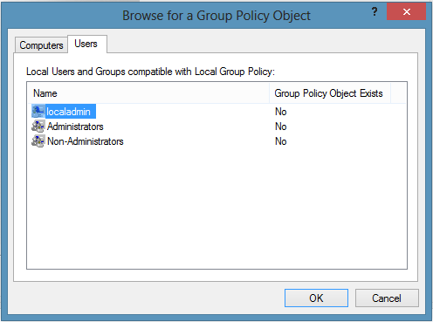
Multiple Local GPOs
Starting in Vista, Local GPOs can be applied to different user types:
  The Computer Only – settings here apply to all users
  Administrators Only
  Non-Administrators Only
  A specific user
Accessed by launching MMC Loading Group Policy Object Editor and browsing. Click Users tab.

Slide 12
Lab
Goal:
  Edit the default local group policy that applies to all users. Enable User Configuration/Administrative Templates/System/CTRL+ALT+Delete Options/Remove Change Password
  Log off and log back in – verify that the setting is removed.
  Edit the LGPO that applies to All Administrators. Disable User Configuration/Administrative Templates/System/CTRL+ALT+Delete Options/Remove Change Password
  Log off and log back in
  Which setting wins?

Slide 13
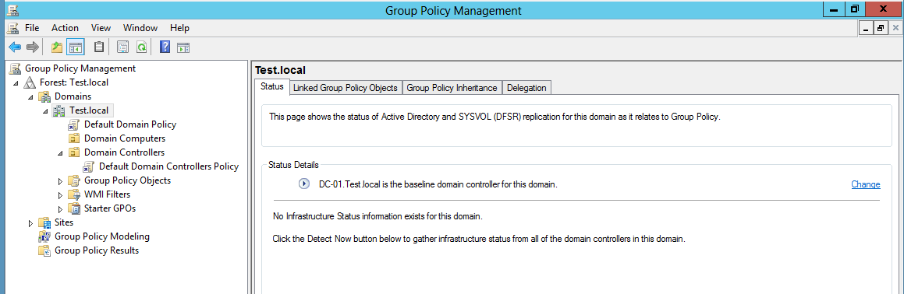
GPMC: Group Policy Management Console
GPEdit allows for management of single GPO
GPMC let’s you see the whole forest – GPOs, links, results, replication, etc

Slide 14
How to get it?
On a domain controller, GPMC is automatically available – but don’t edit GPOs from a DC.
Use on administrative machine by installing the Remote Server Administration Tools (RSAT).
Your administrative machine should be running the highest OS in your environment.
  You shouldn’t be on XP if you support Wind0ws 7 machines.
  As a best practice, you should try to use GPMC from the highest OS Microsoft has available. You will have more settings and more tools.

Slide 15
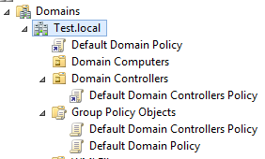
Creating or Linking
GPOs live in the Group Policy Objects Container.
In ADUC, you can find them under the Policies Container
GPOs are linked to an OU. Basically, a link is a shortcut. One GPO can be linked to many OUs
Notice the icon difference?

Slide 16
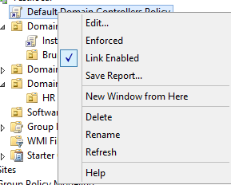
Editing
You can edit a GPO by right clicking on a link or right clicking on the actual GPO itself.
Any editing is live! If a GPO is linked, clients can start picking up your edits before you are finished
Editing a GPO that is linked to multiple OUs means that every one of those OUs will get your changes

Slide 17
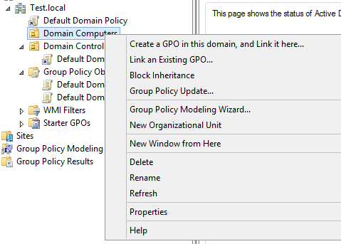
But Joseph?
Yes – you can create a GPO by right clicking on an OU. It will even link it there for you.
But do not do this!
GPOs are always live when done this way.
Instead, Create GPO in container – test – then link.

Slide 18
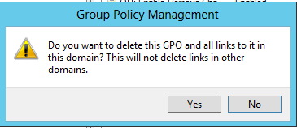
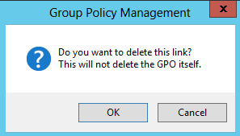
Deleting
Because GPOs live in the Group Policy Objects container, they can only be deleted there.
This is the message when you Delete a link to an OU:
This is the message you’ll get when deleting a GPO.

Slide 19
Built-In GPOs
Two GPOs exist by default
  Default Domain
  Default Domain Controller
Do not edit these (unless to change password policy) – separate changes in separate GPOs
Why? Performance and Standardization
Sorry to be so negative…

Slide 20
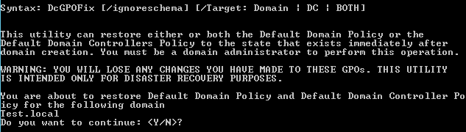
Hypothetical Question – let’s say I changed those two GPOs?
Not a big deal but you will want to revert back to the default settings.
  Compare your GPOs to the default GPOs shipped
  Set those settings in a dedicated policy
  Use DCGPOFix to revert back

Slide 21
Lab
    Create a GPO without linking it
    Remove Change Password
    Then link to an OU
    Change the default domain policy
    Use DCGPOFix (from a domain controller) to revert back

Slide 22
How Group Policy Updates
Two types of updates: foreground and background
  Foreground: a computer starts, a user logs on, a system is brought out of hibernation, and at network changes
  Background:
    Clients: every 90 minutes + 30 minute salt. Max is 120 minutes.
    Domain Controllers: every 5 minutes + No Salt. For large organizations, you can add random delay
Two types of methods: Synchronous and Asynchronous
  Synchronous: CSEs process in order – when one finishes, the next begins. User logs in when all have finished.
  Asynchronous: CSEs process multi threaded – not dependent on each other. User logs in while still processing.
Some CSEs are always foreground and synchronous.
  Drive Mappings, Folder Redirection, Software Installation

Slide 23
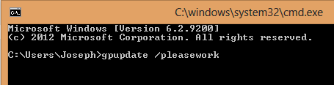
GPUpdate
GPUpdate.exe is the tool used to trigger a Group Policy Update
When an update is triggered, only new policies are applied.
To run, just type GPUpdate from CMD. Only GPOs that have changed will be processed.
To reprocess all GPOs, add a /force

Slide 24
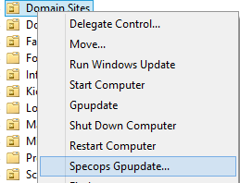
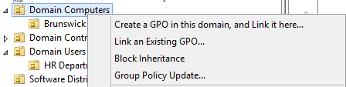
Remote GPUpdate
GPMC for Windows 8 – right click OU and select Group Policy Update
ADUC for Windows 7+ - SPECOPS GPUpdate Free Edition

Slide 25
Configuring Update Behavior
You can change how and how often Group Policy updates
  Settings found at Computer Config/Admin Templates/System/Logon and /Group Policy
  Ex: Set Group Policy Refresh for computers < side benefit – desktop (background/shortcuts) will refresh
You can change Group Policy processing method:
  Settings found at Computer Config/Admin Templates/System/Logon and /Group Policy
  Ex: Always Wait for the Network at Computer Startup and Logon < will slow down machines but will run synchronous

Slide 26
Lab
Determine last time Group Policy processed on client and on a DC
Determine type of processing (Background or Foreground)
Find next processing time
Run a GPUpdate on a client. Does the next processing time change?
Run a GPUpdate from GPMC. Does the next processing time change?
Set the update time for computers to a minute. Run a GPUpdate. When is the next processing time?
You can find this information in the Event Viewer\Applications and Services\Microsoft\Windows\Group Policy

Slide 27
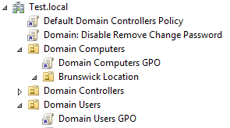
Group Policy Results
Group Policy has two nodes: computer and user. Policies can be configured from each node and policy applies for both object types (computer/user)
Example:
  We have a computer that is located under the OU Domain Computers
  We have a user that is located under the OU Domain Users

Slide 28
Group Policy Results
Our computer will process any GPOs applied to it (such as the domain computers GPO). It will not process the Domain Users GPO.
Our user will process any GPOs applied to it (such as the domain users GPO). It will not process domain computers GPO.
But how can we exactly know what our machines process?

Slide 29
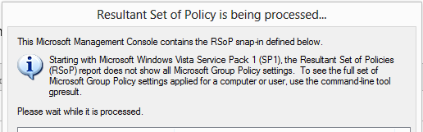
RSOP.MSC: The Old Way
Pre Vista, the best way to get a Resultant Set of Policy was with RSOP.MSC
RSOP is now being phased out
  Doesn’t show logging
  Doesn’t show how policies apply
  Doesn’t show modern CSEs (like GP Preferences)

Slide 30
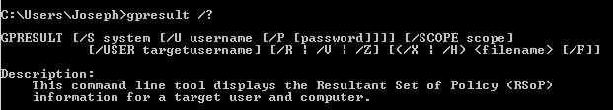
GPResult: The New Old Way
First introduced in Server 2000 as a Toolkit download
Continues to be improved – now supports command line and GUI
Command Line: GPResult /r
GUI: GPResult /h Report.htm

Slide 31
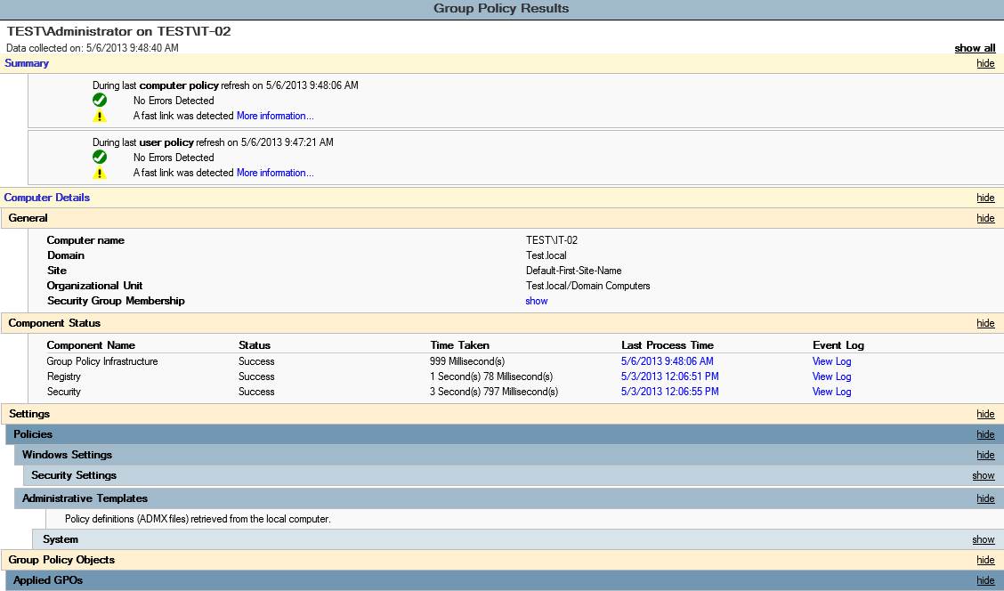
The GUI View

Slide 32
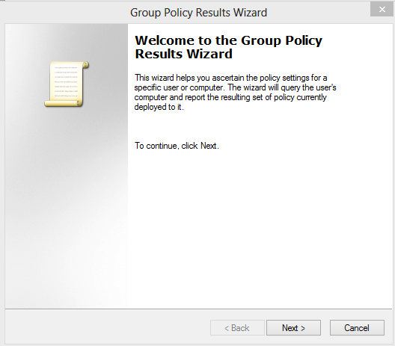
Remote GPResult
Accessed in GPMC – under Group Policy Results

Slide 33
Lab
Use RSOP.MSC to generate a report.
Run a GPResult (command line style)
Generate a GUI GPResult
What added information is available in each type?

Slide 34
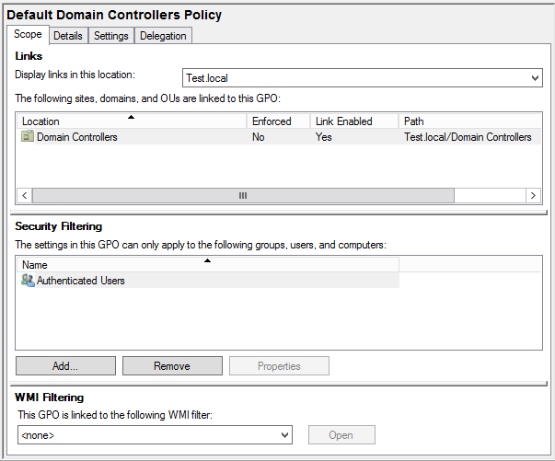
Scope Tab
The scope tab of each GPO controls:
  Links
  Security Filtering
  WMI.
These three items control if a GPO applies – all must be true!
By default, a newly created GPO is unlinked, applies to Authenticated Users, and doesn’t have a WMI filter.

Slide 35
Security Filtering
GPOs can be filtered to: Computers, Users, or Security Groups.
  Special Groups
    Domain Computers = All Computers
    Domain Users = All Users
    Authenticated Users = All Computers and Users
As a best practice, GPOs should be not be filtered to specific computers or users. GPOs should be filtered to groups

Slide 36
Applying to Specific Objects
If you configure a computer side setting, it must be linked to computers
If you configure a user side setting, it must be linked to users*
You can never link a GPO to an OU containing just groups. Groups cannot process Group Policy (odd, I know…)
*Except with loopback – more on this later.

Slide 37
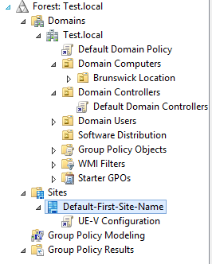
Linking
Policies can be linked at:
  Sites
  Domains
  OUs
Policies cannot be linked at containers (such as Computers, Users, or System) or to a forest

Slide 38
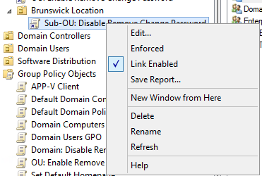
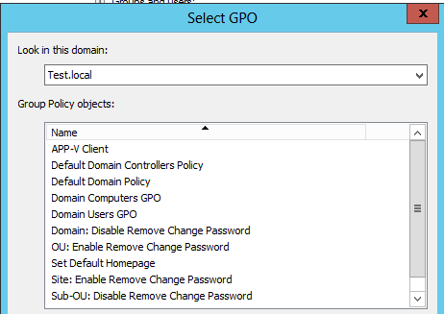

Enabling and Disabling Links
You can link an existing GPO by right clicking on an OU, Domain, or Site.
Enabling/Disabling is known as link status.
You can unlink a GPO by right clicking on it in the OU and deselecting Link Enabled

Slide 39
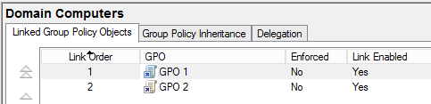
Link Order
Multiple GPOs can be linked to a single OU.
Last GPO linked is the first policy to process
GPOs with a lower links order process later (1 is last)
Can be adjusted with arrows on the left.

Slide 40
WMI
WMI Filters allow conditional filtering but are slow! Use sparingly.
They are stored in the WMI Filters container in GPMC – they are linked to GPOs (and can apply to multiple GPOs)
EX:
  Select * from Win32_OperatingSystem Where OSArchitecture = '32-bit‘
  Select * from Win32_Battery where BatteryStatus <> 0
  select * from Win32_PnPEntity where PNPDeviceID like "%M06030577%"

Slide 41
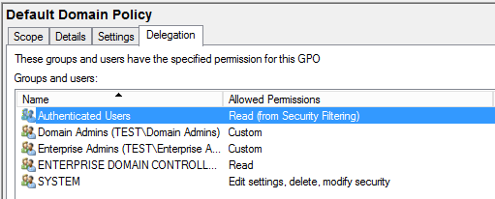
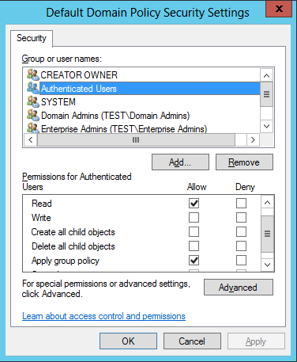
Advanced Permissions
When an object is added to the scope tab, two permissions are added for that object: Read and Apply Group Policy
You can see these permissions in the Delegation Tab and under Advanced.

Slide 42
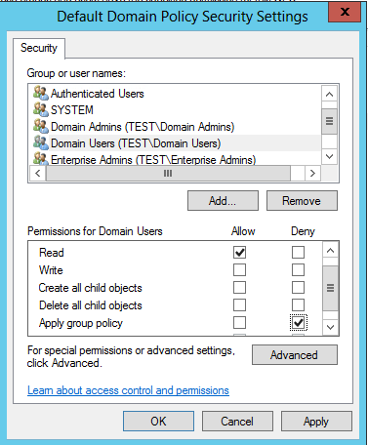
Advanced Denying
You have a GPO applying to Authenticated Users but want to exclude a specific group.
Select Delegation – Advanced and Add your Group. Then Deny Apply Group Policy

Slide 43
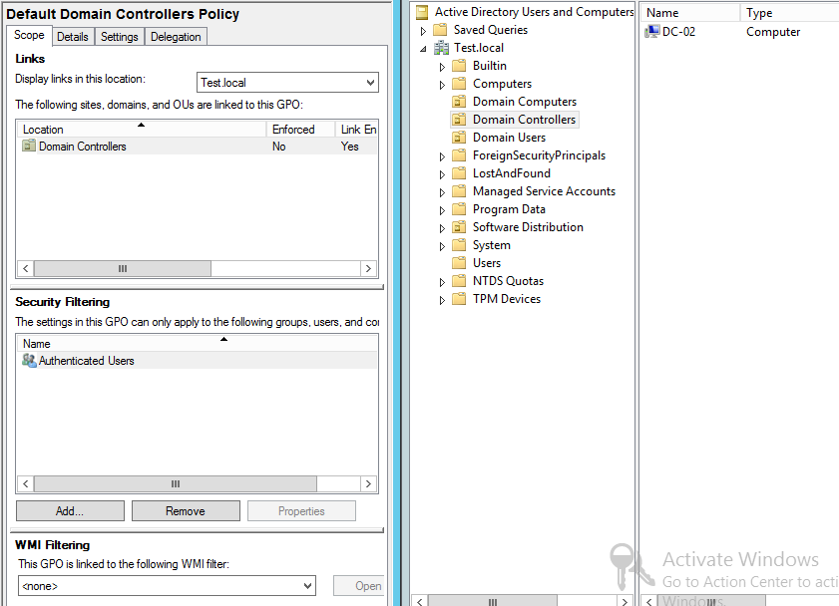
Example 1
Where are we linked?
Who are we filtered to?
Do we have a WMI filter?
What will get this GPO?

Slide 44
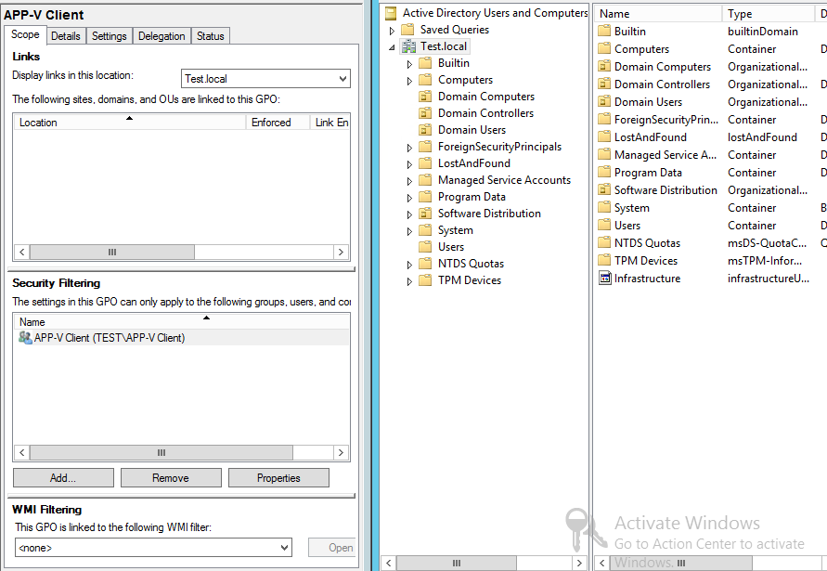
Example 2
Where are we linked?
Who are we filtered to?
Do we have a WMI filter?
What will get this GPO?

Slide 45
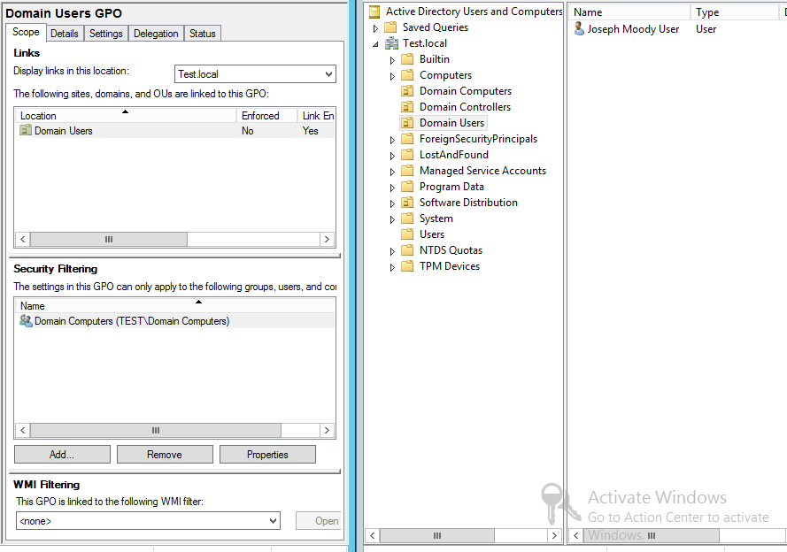
Example 3
Where are we linked?
Who are we filtered to?
Do we have a WMI filter?
What will get this GPO?

Slide 46
Lab
Partner Up!
  Each person: Create three GPOs named Test1, Test2, Test3
  Change some/all of the following:
    Links
    Link Status
    Security Filtering
    WMI
    Advanced Permissions
  Swap machines – figure what objects your partner’s GPOs will apply to.

Slide 47
LSDOU: Like PEMDAS but Better!
Like onions, Group Policy has layers (of processing).
Layer 1: Local Group Policies (First Writer)
Layer 2: Site Linked Group Policies
Layer 3: Domain Linked Group Policies
Layer 4: OU linked Group Policies (Last Writer)
Anytime in Group Policy, the last writer always wins. If you have conflicting settings (let’s say in a domain policy and an OU policy), the closet layer wins
Sub-OUs win over higher OUs.

Slide 48
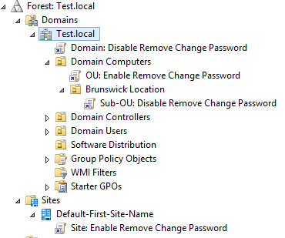
LSDOU Examples
What processes first?
What is next?
Followed by?
And then?
Last?
What is our final setting?
What is the determination (final result) of our policies called?

Slide 49
Lab
Create three GPOs named:
  Site: Enable Remove Change Password
  Domain: Disable Remove Change Password
  OU: Enable Remove Change Password
    Note: These names are not best practices – they are useful for us when troubleshooting and in the next lab.
    Do not configure anything in these GPOs
Link these GPOs to their respective locations (Site GPO to the default first site), Domain GPO to the domain, OU GPO to the OU.
Create a Security Group named “Deny OU: Enable Remove Change Password .” Deny this group the ability to process the OU GPO.

Slide 50
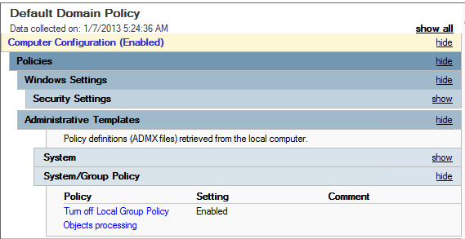
Disable Local Processing
Save yourself the hassle of an additional layer and turn off local group policy.
To do so, Enable Computer Configuration/Policies/Administrative Template/System/Group Policy/Turn Off Local Group Policy Objects processing

Slide 51
Lab
Configure a Local Group Policy setting that applies to all users (ex: Remove Task Manager from CTRL + ALT + DEL). Apply this to a client
Ensure that this setting is being processed.
In a GPO linked to the domain, turn off local group policy processing.
Reboot your client – did local group policy stop?

Slide 52
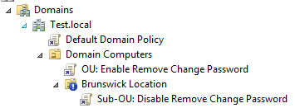

Block Inheritance
Block Inheritance allows you to cut out any GPO from above.
If set on an OU, domain GPOs and higher OU GPOs will not apply.
Why use block inheritance when lower GPOs win anyways?
  Remember that lower only wins if a setting contradicts a higher setting. Block Inheritance blocks all setting from processing (without you configuring a GPO)

Slide 53
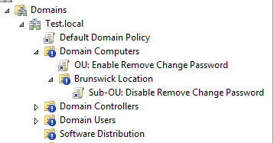
Block Inheritance Best Practices
You can’t block inheritance from a local GPO to an AD GPO. Turn off Local GPO to accomplish this
Don’t use block inheritance (if you can help it). It will cause you more issues than it fixes.
You can block inheritance on a domain but it is odd…
Don’t block inheritance on your Domain Controllers OU – it will break password policies

Slide 54
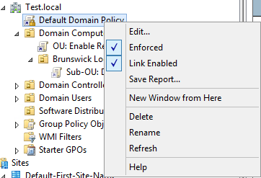
Enforcement – everything you know is backwards
Enforcement allows you to set GPOs from on high without being overwritten.
To enforce, right click on a GPO link and select enforce. This setting is per link – not per GPO.
Enforced GPOs apply backwards (you’ll see on next slide)
Use sparingly or not at all

Slide 55
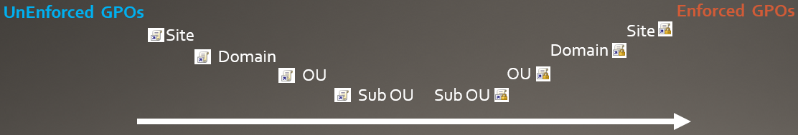
The Ladder Example
Group Policy starts processing and climbs down the ladder. It begins by processing Un-Enforced GPOs.
Order of Processing:
  Site
  Domain
  OU
  Sub-OUs
At the last (closet) OU, enforced GPOs are applied in the reversed order (up the ladder).

Slide 56
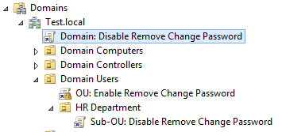
How Enforcement Works: GP Example
Domain: Disable Remove Change Password is not enforced. It processes first.
The next GPO is enforced. GP Client sees this, makes a little reminder to come back to this GPO, and skips it.
Sub-OU GPO is not enforced. It’s setting is applied. We have finished going down the GP ladder.
GPClient then proceeds back up the ladder. Encounters the enforced GPO at the Domain Users OU and applies it.
It is the last GPO to process.

Slide 57
How Enforcement Works: GP Example
These GPOs each contain one setting that is designed as an example.
If the Sub-OU GPO contained different settings that weren’t in the OU GPO, those settings would still apply.
  EX: A setting to remove the task manager.

Slide 58
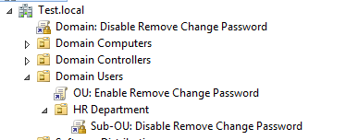
Enforcement: Your Turn
Which GPO wins?

Slide 59
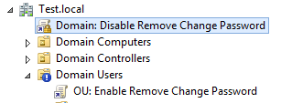
Enforcement and Block Inheritance
Because I know you’ll ask
You have an enforced GPO linked at the domain
You have block inheritance on an OU.
The enforced GPO will win. Enforced ignores block inheritance
Please don’t setup a live environment like this…

Slide 60
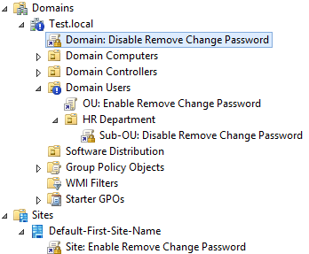
Enforcement and Block Inheritance: Your Turn
What GPO wins?

Slide 61
Lab
Enable Block Inheritance on an OU or Domain. Test out what policies apply and which policies don’t apply
Set two GPOs to enforce. Which one applies?
Enable Enforce on a GPO above the block inheritance. Ensure that it applies.

Slide 62
Loopback: Your Solution to Everything*
Remember these rules?
  If you configure a computer side setting, it must be linked to computers
  If you configure a user side setting, it must be linked to users
But what if you want to apply a user side setting (ex: a home page) to a group of computers? Use Loopback!
Loopback can be configured at Computer Configuration/Administrative Templates/System/Group Policy/Configure user Group Policy loopback processing mode.
Does not require a reboot!
* Everything that consists of user side settings needing to apply to computer objects

Slide 63
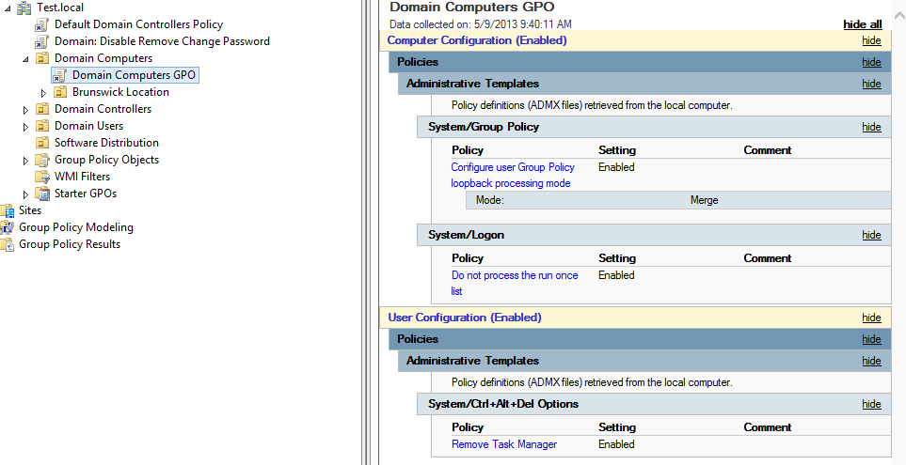
What would normally happen:
The User Side setting, Remove Task Manager, will be ignored by the computers in the Domain Computers OU.

Slide 64
What would happen with Loopback
The User Side setting, Remove Task Manager, will be processed by the computers in the Domain Computers OU.

Slide 65
How does Loopback work
No Loopback
  Computer Starts/Contacts DC
  Gets all GPOs linked to it
  Processes Computer Node (ignores user node)
  Presents Login Screen
  User Authenticates
  Gets all GPOs linked to it
  Processes User Node (ignores computer node)
  User is logged in
With Loopback
  Computer Starts/Contacts DC
  Gets all GPOs linked to it
  Processes Computer Node (ignores user node)
  Presents Login Screen
  User Authenticates
  Gets all GPOs linked to it
  Processes User Node (ignores computer node)
  Computer says “shoot, I can be a user too”
  Gets all GPOs linked to it (the computer)
  Processes User Node (ignores computer node)
  User is Logged in

Slide 66
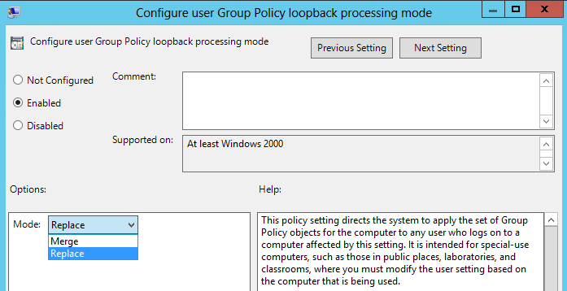
Additional Info about Loopback
Comes in two modes: Merge and Replace
  Merge adds in the user’s setting + user node settings linked to the computer
  Replace only uses user node settings linked to computer
Loopback changes processing for the entire computer – not just one GPO.

Slide 67
Loopback Modes: Merge and Replace
Merge Mode
  Computer Starts/Contacts DC
  Gets all GPOs linked to it
  Processes Computer Node (ignores user node)
  Presents Login Screen
  User Authenticates
  Gets all GPOs linked to it
  Processes User Node (ignores computer node)
  Computer gets all GPOs linked to it
  Processes User Node (ignores computer node)
  Computer merges it’s extra settings to the User’s RSOP
  User is Logged in
Replace Mode
  Computer Starts/Contacts DC
  Gets all GPOs linked to it
  Processes Computer Node (ignores user node)
  Presents Login Screen
  User Authenticates
  Gets all GPOs linked to it
  Processes User Node (ignores computer node)
  Computer gets all GPOs linked to it
  Processes User Node (ignores computer node)
  Computer replaces all settings grabbed by the user with it’s User Node settings

Slide 68
Lab
Ensure that you have a setting configured for a user (such as removing a CTRL + ALT + DEL option)
Set a user side setting on a GPO linked only to a computer. Does it apply?
Enable loopback. Do you have to reboot for this to take effect?
Get your user side setting (that is linked to a computer) to apply for all users.
  Have Loopback merge the settings (and ensure this)
  Have Loopback replace the settings (and ensure this)

Slide 69
Policy/Policy Setting/Registry Policy/ADMX
All of these names mean the same thing – basically everything under Administrative Templates. For simplicity, I will try to call them Policy
Stored in C:\windows\PolicyDefinitions\ on every single machine
Language independent and XML based.
Available for 3rd party software: Office, Adobe, NetSupport, etc

Slide 70
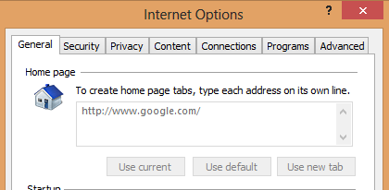
The Two Traits of Policies
Not Tattoo Settings
  If you configure a setting (ex: User Config/Administrative Templates/Windows Components/Internet Explorer/Disable changing home page settings) and later remove that setting from the GPO, the computer will also remove setting.
Takes Precedence
  A policy will always be the default setting once configured. When you configure a specific setting, the user will not be able to override the setting.

Slide 71
Pros and Cons of Policy
Pros of Policy
  What you set is what they get – if an application supports policy, configuration is as easy as enabling a setting.
  Reversing a change only requires one click (change the setting to Not Configured)
Cons of Policy
  Very restrictive – ex: setting a homepage doesn’t allow users to set secondary homepages
  Can “lock out” admins as well (ex: trusted sites)
  Frustrating when 95% of an application can be configured but you need to manage that 5% that isn’t support – ex: some desktop settings, start screen, etc

Slide 72
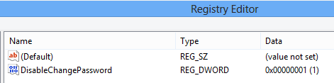
Where do the settings live?
When you configure an individual policy (ex: Remove Change Password”, it is stored on clients in a special location.
If it is in the computer node:
  HKLM\Software\Policies
  HKLM\Software\Microsoft\Windows\CurrentVersion\Policies
If it is in the user node:
    HKCU\Software\Policies
  HKCU\Software\Microsoft\Windows\CurrentVersion\Policies

Slide 73
How do they work?
Applications have to know to look in the special policy locations on startup.
For example, Explorer.exe knows to look in the registry on login and every time Widows Explorer is launched.
The application is able to remove/set the options you configured

Slide 74
Bypassing Policy
By default, all four registry locations have extra security permissions on them to prevent standard users from changing them
This even applies to the registry keys HKCU!
Local Administrators can bypass your restrictions though by deleting/modifying these registry settings. Another reason why you shouldn’t have local admins…

Slide 75
Lab
Configure a Group Policy setting and find it in the registry
Login as an administrator and remove/change this setting
Run a GPUpdate – does the setting get replaced? Why?
Run a GPUpdate /force – does the setting get replaced? Why?

Slide 76
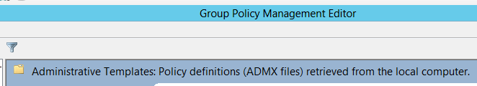
Back to the GPMC
When the GPMC loads, it pulls all of the definitions (Administrative Templates) from your local machine.
As long as you are running the latest OS, this isn’t a real big problem. You would always have every setting.
  But what happens if an update is released? Or if you have GP admins that don’t want to always update their machine?
  What happens if you add a bunch of custom ADMX files and lose your computer?

Slide 77
The Central Store
Beginning in Vista, the GPMC could look in a network location for definitions instead of the local machine
Meaning that all GP admins would share the same definitions and always have the latest versi0ns
Any extra ADMX settings added (Office as an example) would automatically be available for every other GP admin.

Slide 78
Creating the Central Store
Browse to the Policies folder in SYSVOL: \\TEST.Local\SYSVOL\Test.Local\Policies
Create a new folder named PolicyDefinitions
Copy your local definitions (ADMX files only) to the new PolicyDefinitions folder
Copy the en-US folder (which contains the ADML files)
Close and Reopen the GPMC

Slide 79
Lab
Create the central store
Ensure that GPMC is using it.

Slide 80
What is a preference?
Any setting that tattoos a setting – as in leaves the setting behind when no longer applicable
Any setting that allows the user to work around it.
Biggest example is Group Policy Preferences.
Another example: Internet Explorer Maintenance (yes, the same one that lives in the Policies node)
  Stores settings at: HKCU\Software\Microsoft\Windows\CurrentVersion\Internet Settings

Slide 81
Why use a preference?
To set default settings.
  Ex: You would like to set the default homepage but allow users to change it
To configure applications that don’t support policy
  Using GPPrefs: Files, Registry, INI, etc to deploy preconfigured settings
To eliminate logon scripts
  GPPrefs are faster, GUI based, and highly configurable

Slide 82
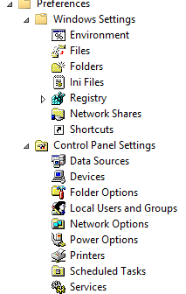
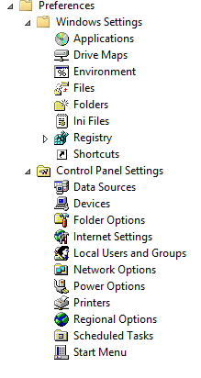
Power of the Preferences

Slide 83
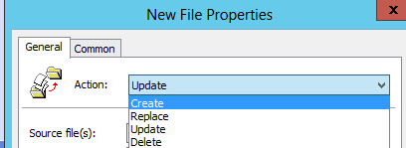
CRUD! 4 More Things to Remember
Create: creates the preference item. Will not edit anything that already exists.
Replace: deletes the existing item and creates a new one. Will not create if item doesn’t exist.
Update: will create item if it doesn’t exist. Replace if it does.
Delete: well, deletes the item
Preferences without CRUD default to Update (ex: Internet Explorer Properties)

Slide 84
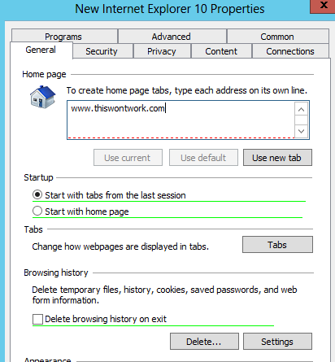
Why is word spellchecking?
Some preferences are GUI replicas of programs. EX: Internet Explorer Properties
Red = setting won’t apply, marked as inactive
Green = setting will apply, marked as active

Slide 85
Enabling/Disabling Preference Components
Use these keys:
  To enable everything on a tab, press F5
  To enable a specific setting, select the setting and press F6
  To disable a specific setting, select the setting and press F7
  To disable everything on a tab, press F8

Slide 86
A Word of Caution
Did you notice how some items were already green (active)?
If you ever create a Preference like this, only visit the tabs you need to configure. Disable any active item that you do not need.
If you looked at a tab with active settings and changed something on a different tab, all green settings from all tabs you visited are saved!

Slide 87


A Word of Caution: Example
Default Setting within IE
Within Preference

Slide 88

Common Tab
Stop Processing: Used to speed up GPPs instead of letting a GPP error out
Run in: Used for least privilege as GPPs almost always run in system context (Drive Mappings/User Printers do not)
Remove: We’ll talk about this one:
Apply Once: It is serious about what it says – will not even apply again with a GPUpdate /force
ILT: WMI on Steroids

Slide 89

Remove this Item When it No Longer Applies
When checked, the preference item is switched to replace.
When preference falls out of scope, the entire item is removed (not just the specific setting)
DefaultKeyboardSize registry key isn’t set back to 100 or even to a blank setting – the entire item is deleted and the application breaks

Slide 90

ILT
Item Level Targeting is a GUI based filtering that acts like WMI (ex: computer must match this name or be a member of this OU)
Multiple targets can be combined with AND or OR statements
Can use NOT statements

Slide 91

ILT Example

Slide 92

ILT Example

Slide 93


ILT Collection Example
Collections allow you to group statements together into a single target
EX 1: this ILT will apply if the OS is Windows 8 or if the computer is in two OUs
EX2: this ILT will apply if the OS is Windows 8 and if the computer is in one of two OUs

Slide 94

F3 – Yet Another Hidden Menu
Anywhere in GPPrefs (even ILTs), you can take advantage of environment variables.
You can also use variable specifically made for GPPrefs by pressing F3.
Ex: %COMMONDESKTOPDIR% = C:\Users\Public\Desktop\

Slide 95

Creating a File
Source file can either be local or UNC.
Destination must be a local path.
Two wildcards:
  * means all characters
  ? means one character

Slide 96

Creating a Printer
Computer Side: IP Printers – can’t be set as a default. Last written printer is set as default. Faster
User Side: IP or Shared. Can be set as default. Slower.

Slide 97

Point and Print Restrictions
Vista+ introduced additional security for printer drivers.
Your Print Server must be marked as a trusted driver source.
Alternatively, you can tell clients to just trust every server.
Computer Configuration\Administrative Templates\Printers\Point and Print Restrictions

Slide 98

Troubleshooting Preferences
First place to start: Application in the Event Viewer
Second place: Group Policy detailed log (Event Viewer\Applications and Services Log\Microsoft\Windows\Group Policy

Slide 99
What would win? Policy or Preference?
Policy – not much else to say here…

Slide 100
Lab
Create a file preference
Create a printer preference (printer already installed on DC)
Create an IE preference – enable certain settings.
Create ILTs for each preference

Slide 101

Security
Found under Computer Configuration\Windows Settings\Security Settings
Manage rights, auditing, local machine settings
Manage Group Membership
Set File/Registry Permissions
Configure Firewall, Software Restriction/AppLocker
Set Wireless Profiles

Slide 102
Security Processing
When will a GPUpdate happen?
How often does it happen?
Will a policy reapply if it hasn’t been changed?
The Security CSE will automatically reprocess all settings every 16 hours regardless of changes in the GPO.

Slide 103

Security Settings: Local Policies
Not the same a local GPO – these are security settings
Three sections: Audit, User Rights Assignment, Security Options
  User Rights Assignment control permissions such as Deny Log On Locally and Run as a Batch
  Security Options control device restrictions, Interactive Logon (CTRL+ALT+DEL), UAC, etc

Slide 104


Restricted Groups
Allows you to specify local and domain group membership.
  Members
  Member Of
Local Administrator is assumed added. Domain Administrators are not.

Slide 105


File System/Registry Security

Slide 106
Lab
Create a security group named Helpdesk. Use restricted groups to make Helpdesk an member of administrators in Domain Computers
Give Helpdesk Full Control to C:\Data\ on your client. You will need to create this folder first (consider using GPPrefs Folders)
Use Group Policy to rename the local administrator account on all domain computers
Require CTRL + ALT + DEL to login

