Slide 1
How to: Get the Computer Name

Slide 2
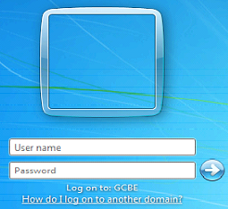
At the Logon Screen (1)
If a computer is at a logon screen, you can get the computer name by clicking on “How do I log on to another domain”

Slide 3
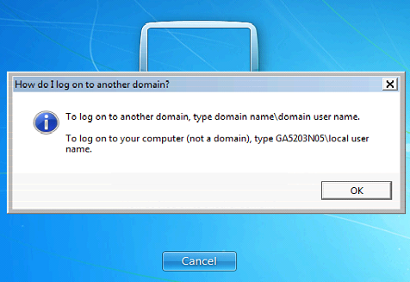
At the Logon Screen (2)
The computer name will appear in the box that appears. In the picture below, the computer name is GA5203N05

Slide 4
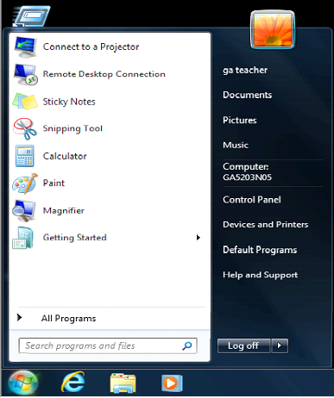
When logged in as a teacher
If a teacher is logged in, the computer name can be found under the start menu. In the picture below, the computer name is GA5203N05.

